Slide 1
10 Steps to Becoming a Tidyverse Contributor
library(dplyr)
rladies_global %>%
filter(city == 'Lancaster')
Nic Crane

Slide 2


Hello!
Nic Crane
@nic_crane

Slide 3
Who here…
Knows what the Tidyverse is?
Tweets about R?
Blogs about R?
Has written an R function?
Uses git?
Has written an R package?
Has a package on CRAN?
Has contributed to a Tidyverse package?

Slide 4
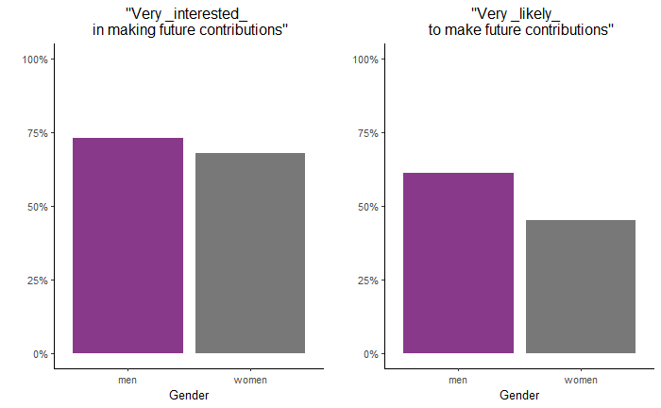
The gender imbalance in open source remains profound…Open source contributors don’t yet reflect its broad audience of users
—GitHub Survey 2017

Slide 5
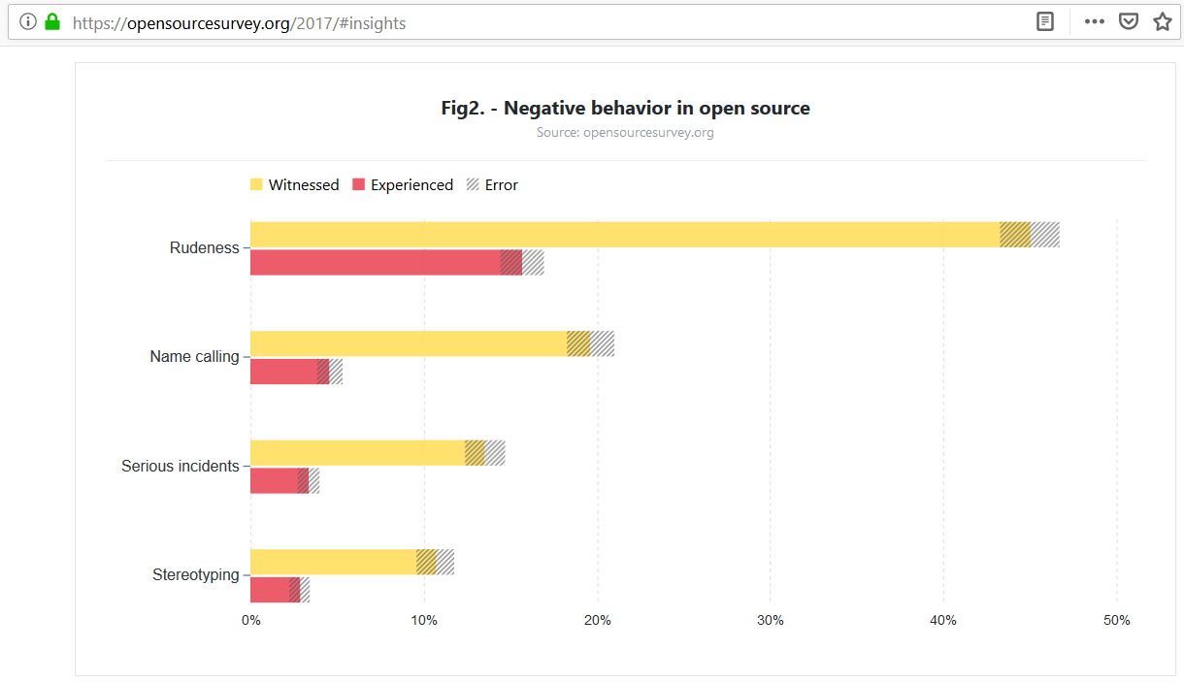

Slide 6
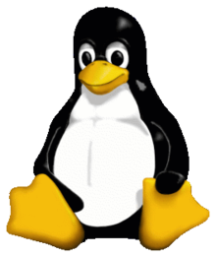

Culture is Changing in Open Source
Notes:
Stack Overflow: In 2016, a research paper showed that 5.8 per cent of active contributors are women even through 20 per cent of visitors are women. Stack Overflow actively admitted that the community there could be hostile to women, people of color, and marginalized groups, and has promised to do better. In August, this they released their new code of conduct which explicitly tackles aggressive behaviour.
In September, Linus Torvalds, the creator of Linux, issued an apology for years of aggressive behaviour and promised to get help whilst also releasing a new code of conduct.

Slide 7
How Does R
Compare?
2017: “The R community is one of R’s best features”
2012: RLadies Founded
2015: R Forwards set up
2011: rOpenSci Founded
2015: R Consortium established
2016: “The R community is awesome (and fast)”
2017: RStudio Community Forums goes live

Slide 8
Why Should You Contribute?
GITHUB SURVEY 2017
“Half of contributors say that their open source work was somewhat or very important in getting their current role.”
“Open source work helps people build their professional reputation.”
“Improving contributor representation can help create a more representative tech sector overall.”

Slide 9
Why Should You Contribute?
MY PERSONAL REASONS
Improve code knowledge
Interact with the community
Overcome Lessen imposter syndrome

Slide 10

When I started my transition into data science, I said yes to pretty much every opportunity that came my way, even if it felt slightly beyond my skill set or experience level...I said yes to many of these things when it felt like I wasn’t sure if I was ready.
—Julia Silge
Interview with And Comfort (October 2018)

Slide 11

Not always easy for beginners. Helps to have a team that will onboard. Give beginner level work. Mentorship. Pick projects that are welcoming.
—Gabriela de Queiroz [summarised tweet]
Grace Hopper Celebration of Women in Computing (2018)

Slide 12
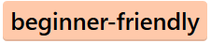


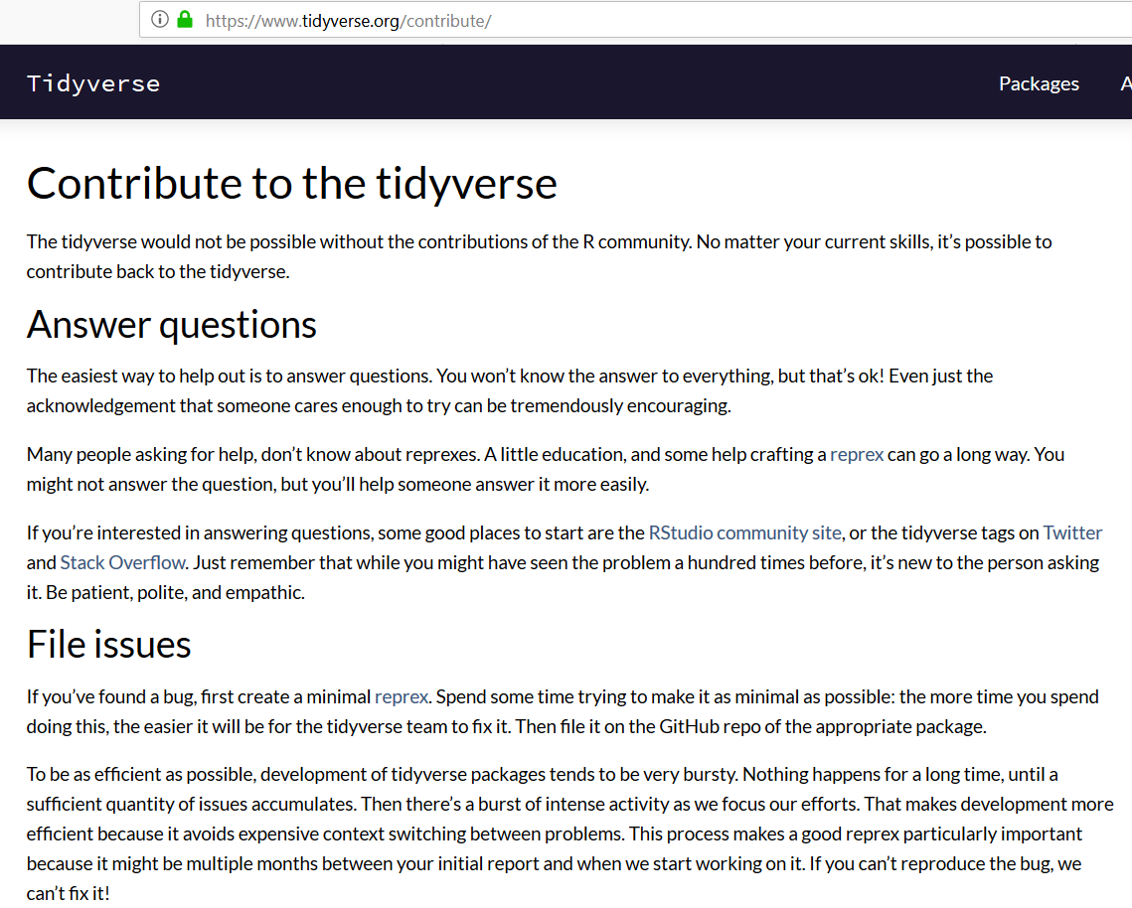

The tidyverse is a great place to get involved

Slide 13
Step 1 Decide How to Contribute
Identifying issues
Documentation
Helping people out on Twitter and forums
Blogging
Code
Notes:
Not just code! Plenty of other ways, and they’re all important!

Slide 14
Step 2 Learn!
R functions
git (clone, commit, push)
Building R packages (basics)
GitHub – making a pull request
Notes:
Whilst there is some pre-requisite knowledge required to contribute code to R packages, it’s not as much as I expected. You absolutely should be comfortable with working with and writing functions in R. Beyond that, some familiarity with git is needed – things like clone, commit, and push, though doing it all via RStudio is fine. You’ll need to know the basics of R package building – when I say basics, what I mean is that you’re not writing a package from scratch, so don’t need to know every detail. Finally, you’ll need to know how to create a pull request on GitHub, which, once you’ve conquered the other items on the list, fairly uncomplicated. I’ve linked to resources for all of these things at the end of this post.
https://ropensci.github.io/dev_guide/contributingguide.html

Slide 15
Step 3 Find an Issue
Notes:
The next step is finding an issue to work on. Luckily, many issues are tagged on GitHub with “beginner friendly”, “help wanted”, or “good first issue” to help point you in the right direction.

Slide 16
Step 3 Find an Issue
Notes:
In the GIF here, I show how to get from the CRAN page for a package – broom in this case – to a potential issue to work on. I first click on the URL next to “BugReports” to get taken to the GitHub issues page. Next I find a relevant tag – “beginner friendly” in this case. Once I click on the tag, I’m shown all issues with that tag. I then pick one, and read the description to see if it’s something I think would be good to look at getting involved with.

Slide 17
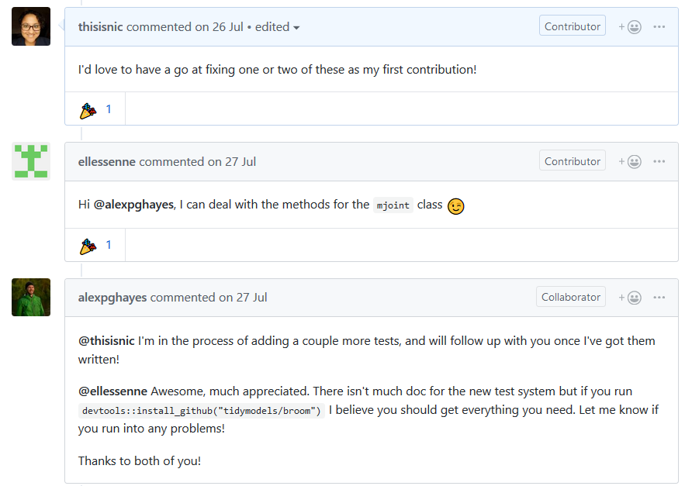
Step 4 Ask if You Can Help
Notes:
You can’t just wade in there and make a start
Don’t want to duplicate work that someone else is doing
Check they actually need help

Slide 18
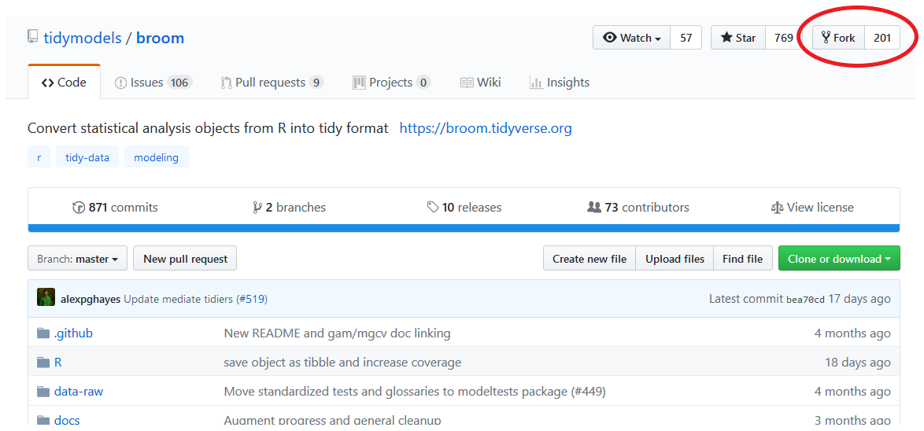
Step 5 Fork the Repo

Slide 19
Step 6 Open in RStudio & Make a Branch

Slide 20
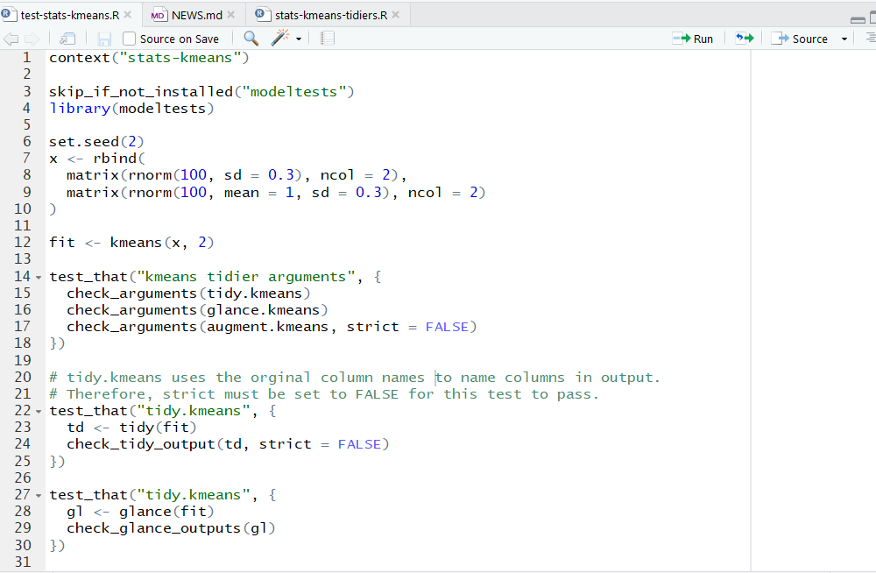
Step 7 Familiarise Yourself with the Code

Slide 21
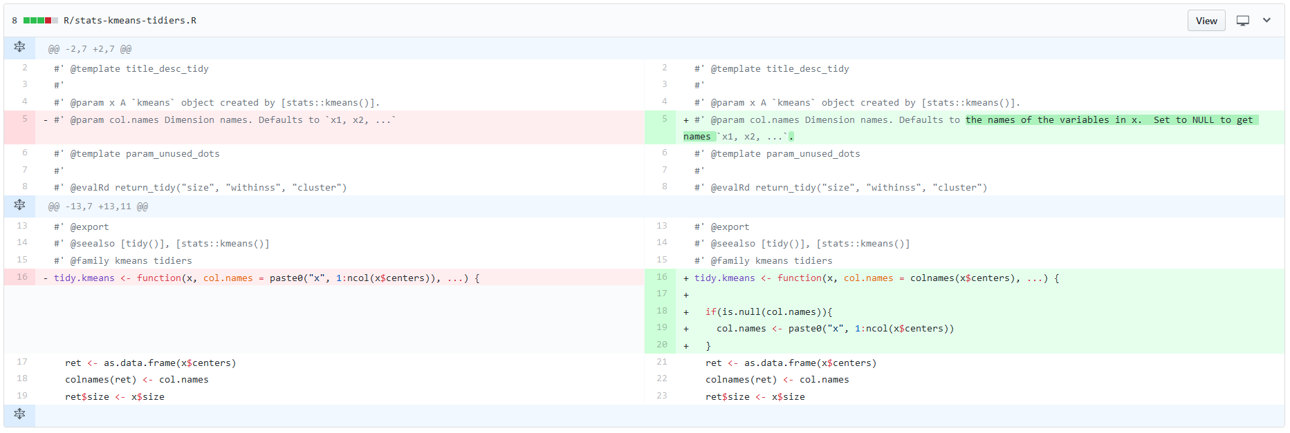
Step 8 Write Code
Notes:
Be succinct, don’t introduce new dependencies

Slide 22
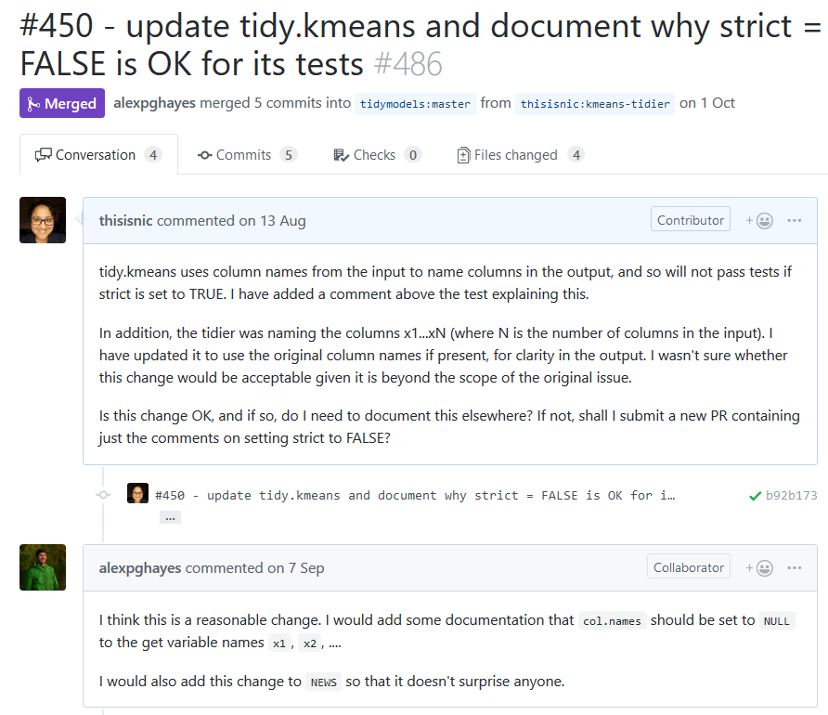
Step 9 Submit PR and Wait
Notes:
Other people have lives, nerd; don’t be impatient! ;)

Slide 23
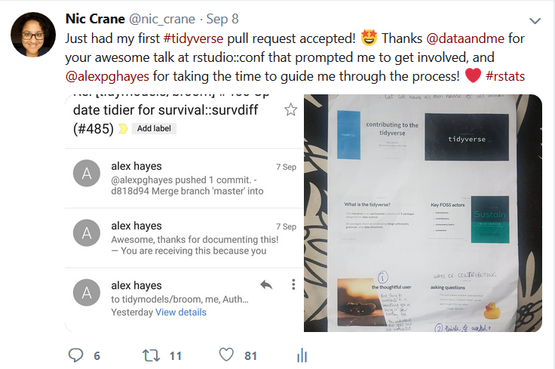
Step 10 Celebrate! Then Encourage Others to Get Involved and Share Your Experience

Slide 24
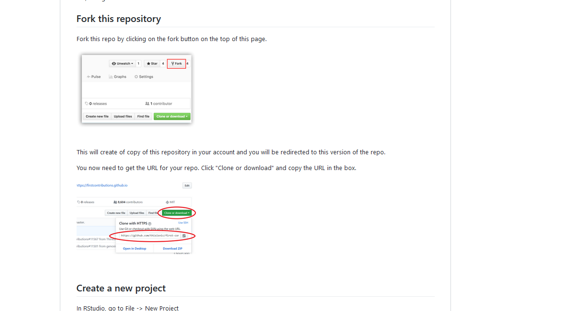
Never Submitted a PR Before? Check out the first contributions repo!
https://github.com/thisisnic/first-contributions

Slide 25
Other ways to get involved
Blogging
Screencasts
Tweets
GitHub gists

Slide 26
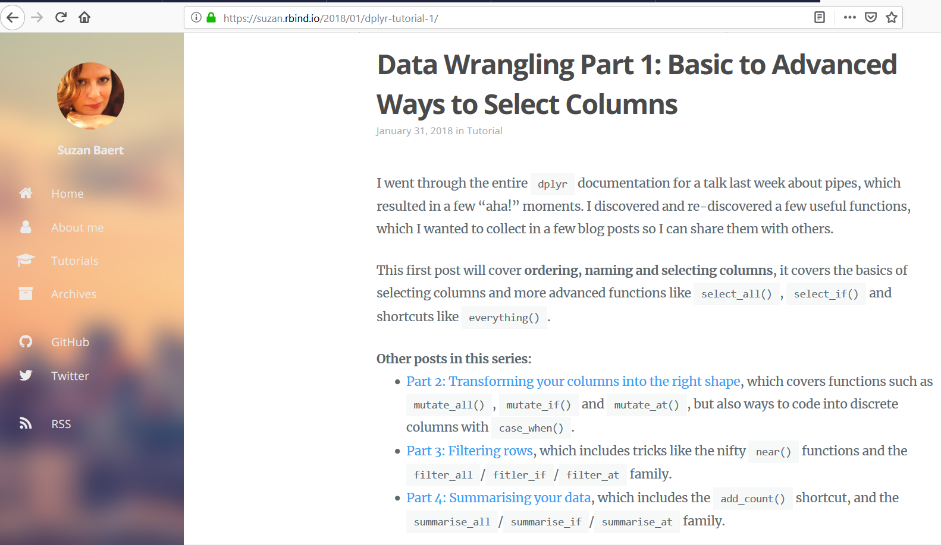
Blogging

Slide 27
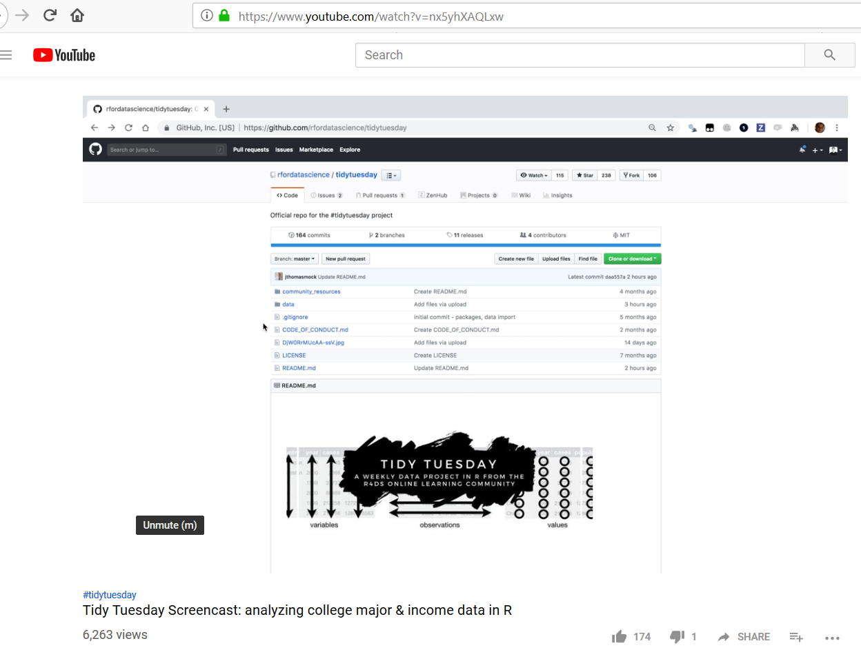
Screencasts

Slide 28
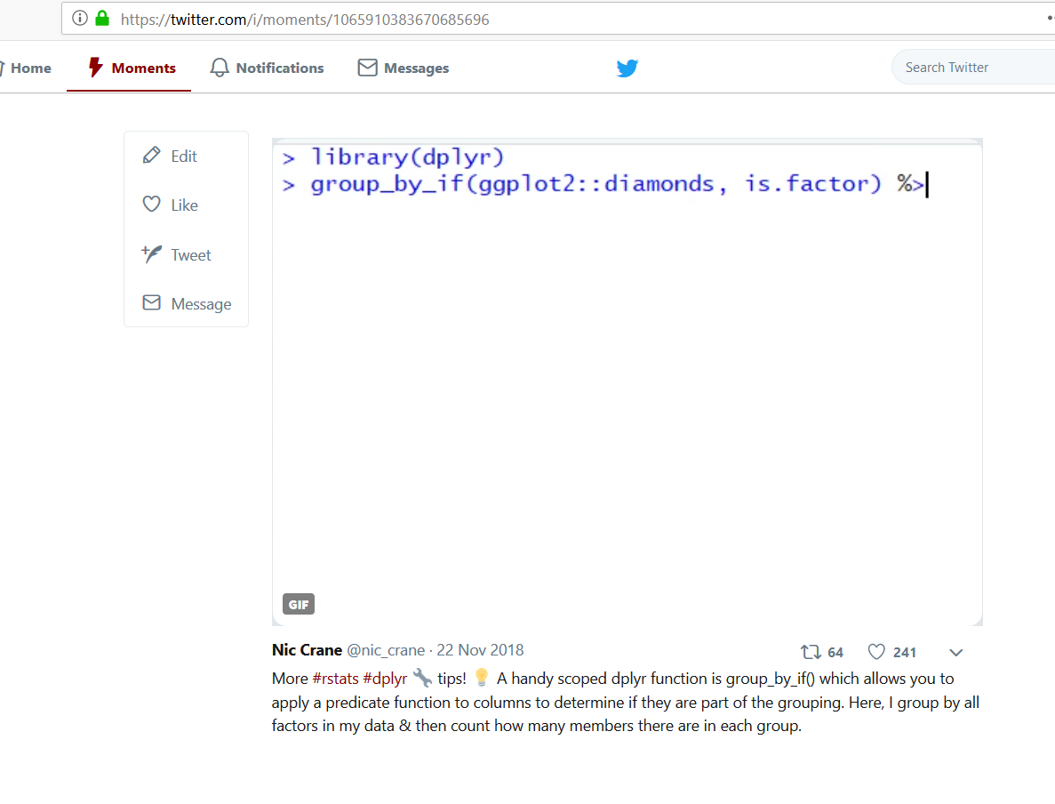
Tweeting

Slide 29
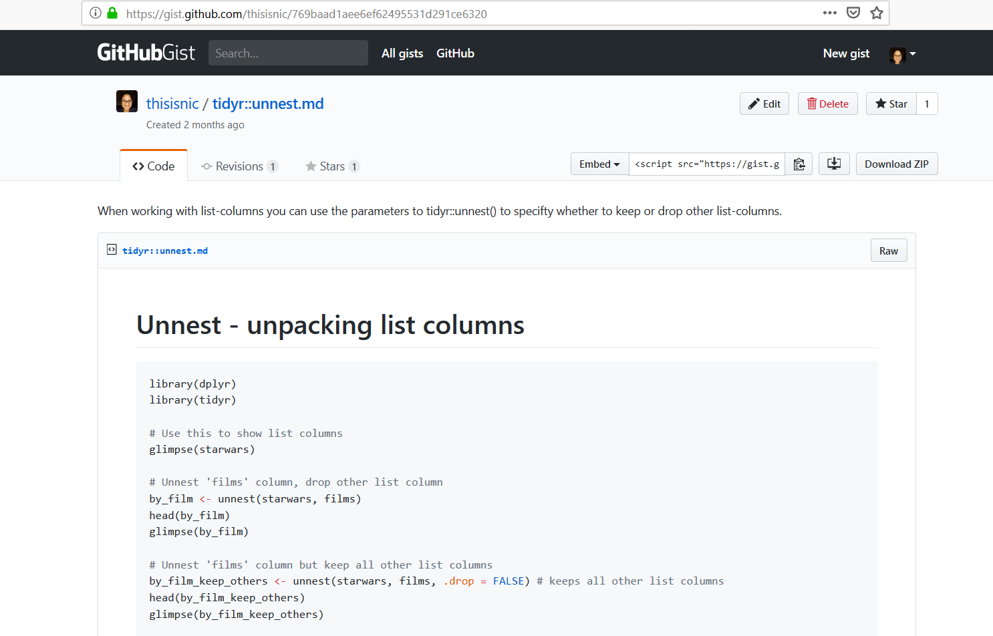
GitHub Gists

Slide 30
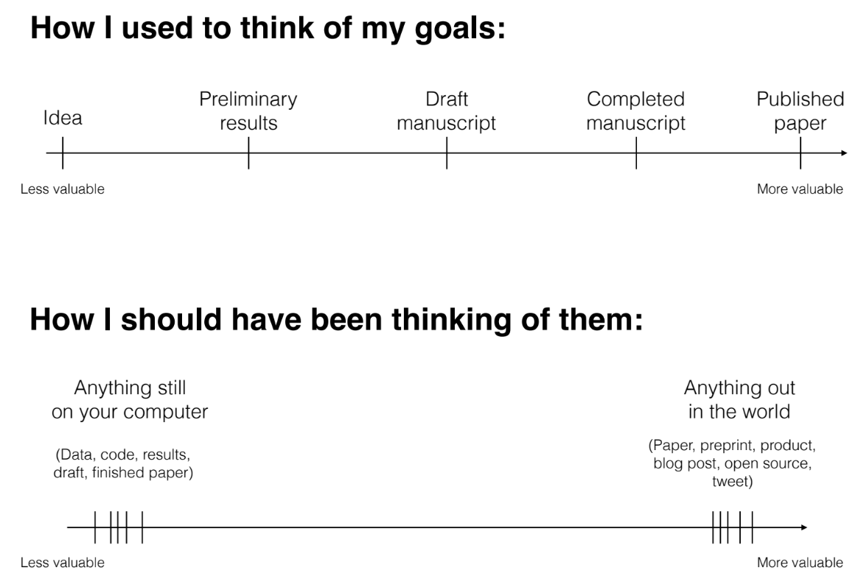
“The unreasonable effectiveness of public work” – David Robinson

Slide 31
Resources
Talk by Mara Averick on contributing:
https://www.rstudio.com/resources/videos/contributing-to-tidyverse-packages/
rOpenSci contributing guide:
https://ropensci.github.io/dev_guide/contributingguide.html
Repo walking through making a pull request:
https://github.com/thisisnic/first-contributions
Guide to contributing code to the tidyverse:
https://www.tidyverse.org/articles/2017/08/contributing/
Talk by David Robinson on public work:
https://resources.rstudio.com/rstudio-conf-2019/the-unreasonable-effectiveness-of-public-work

Slide 32
Thanks! ☺
Nic Crane
@nic_crane

